Slide 1
Text Mining for Cyber Security - CISA Threat Advisory Feed
By: Norberto Limon Jr

Slide 2

Agenda
Objective
Related Research
Threat Intelligence
Domain Specific Context
Threat Intel Feeds
CISA
Building a CISA Advisory Feed
Jupyter Notebook Demo

Slide 3
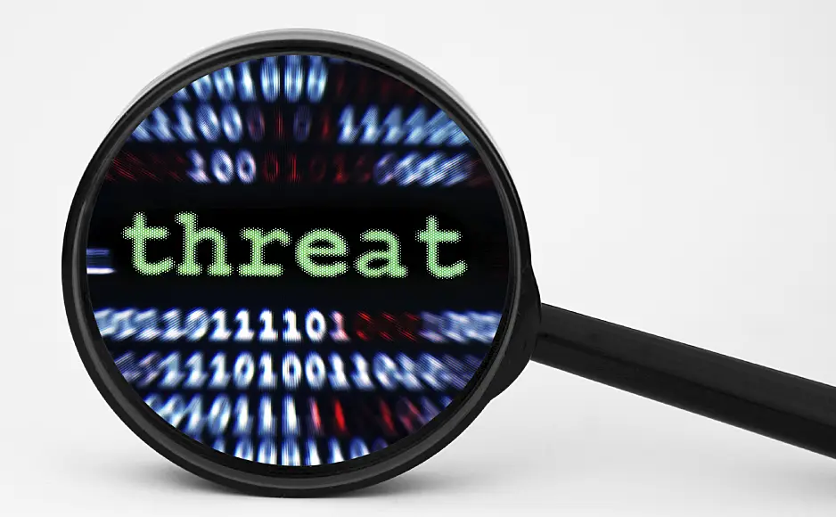
Objective
Using a combination of Text Mining and Data Wrangling, we will be extracting information to create a rolling feed of the most recent cybersecurity advisories given to industries by the Cybersecurity and Infrastructure Security Agency in response or anticipation to cyber attacks.
In other words we will be using text mining to create a dynamic threat feed of the latest alerts and advisories published by CISA for consumption by target industries in the private sector.

Slide 4

Related Research
Ignaczak, L., Goldschmidt, G., Costa, C. A. D., & Righi, R. D. R. (2021). Text Mining in Cybersecurity. In ACM Computing Surveys (Vol. 54, Issue 7, pp. 1–36). Association for Computing Machinery (ACM). https://doi.org/10.1145/3462477
Solanke, A. A., & Biasiotti, M. A. (2022). Digital Forensics AI: Evaluating, Standardizing and Optimizing Digital Evidence Mining Techniques. In KI - Künstliche Intelligenz (Vol. 36, Issue 2, pp. 143–161). Springer Science and Business Media LLC. https://doi.org/10.1007/s13218-022-00763-9

Slide 5
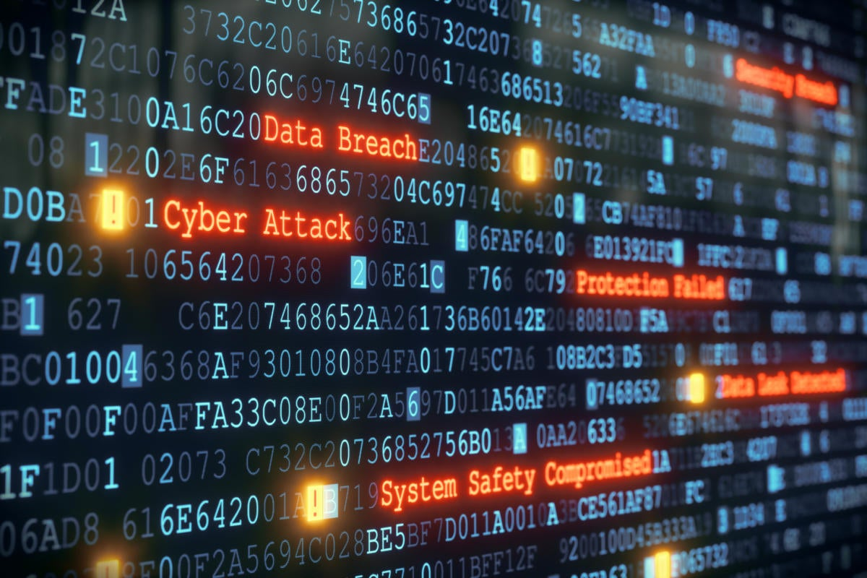
Threat Intelligence (TI)
Threat intelligence is data that is collected, processed, and analyzed to understand a threat actor’s motives, targets, and attack behaviors. Threat intelligence enables security teams to make faster, better informed, data-backed security decisions and change their behavior from reactive to proactive in the fight against threat actors.
Insights and data from the threat intelligence feeds can be used to:
Block known malicious sources
Support threat detection
Prioritize alerts and guide remediation activities
Add context during an investigation
Source: https://www.crowdstrike.com/cybersecurity-101/threat-intelligence/

Slide 6
Threat Intelligence (TI)
Ideally your CTI will focus on hacker groups that specialize in, or vulnerabilities that are unique to, your organization’s infrastructure. There are for instance groups such as these that focus on industrial control systems with intent to cause physical damage. Those motivated by financial incentives will typically target large companies or powerful startups or banks. In recent years there has been a growing surge in cyberattacks on vehicles and satellites with the intent and capability to compromise the controls.
Some companies that provide TI platforms include OpenCTI,

Slide 7
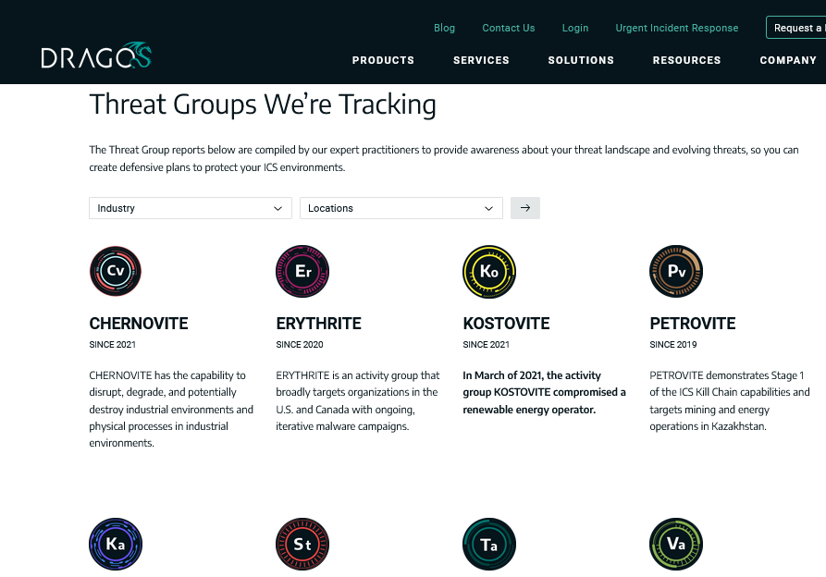
Domain Specific Threat Actors
Ideally your CTI will focus on hacker groups that specialize in, or vulnerabilities that are unique to, your organization’s digital infrastructure. There are for instance groups that focus on industrial control systems with intent to cause physical damage for political reasons, others motivated by financial incentives that typically target large companies, powerful startups or banks. In recent years there has been a growing surge in cyberattacks on cloud environments and IoT devices including Industrial IoT, vehicles and satellites with the intent and capability to compromise their controls.
One of the earliest and most well known of these types of attacks was one suspected of being done by the NSA and an Israeli cyber intelligence agency in an attack on a nuclear subterfuge in Iran that was believed to be enriching uranium for military application. That attack was called Stuxnet and we are now seeing tons more of these kinds of attacks in large numbers..

Slide 8
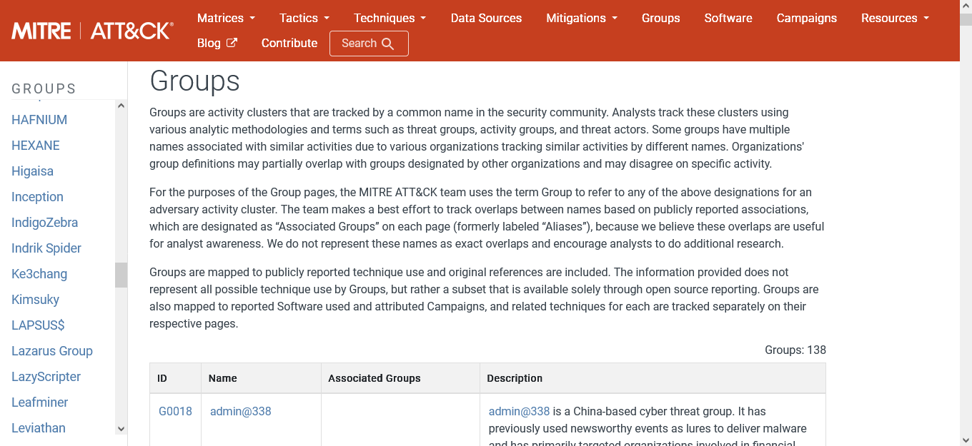
More Threat Groups and MITRE ATT&CK

Slide 9
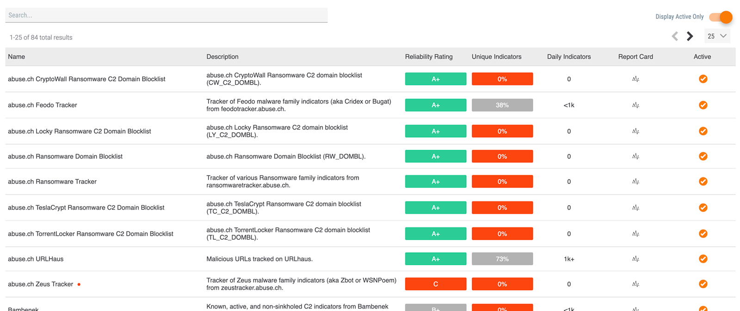




Threat Intel Feeds
Also known as threat feeds or cyber threat bulletins, threat intel feeds are aggregators of cyber threat actor information that is used for proving early warning, detection and mitigation information as well as contextual and situational awareness.
Some things you might find in an intel feed:
Indicators of Compromise (IoCs), news articles, OSINT Twitter, Threat Group activity, hacker forums, risk scores, relevance metrics, etc in a real time feed.
Notes:
Think RSS but for cybercrime and geopolitics.

Slide 10

Cybersecurity and Infrastructure Security Agency (CISA)
CISA is a government agency that is responsible for strengthening and infrastructure protection across all levels of government.
Recently formed in 2018 and became mos well known for the Director, Jen Easterly’s “Shields Up” Campaign which provided actionable information and clear, detailed guidance in anticipating and navigating the cyberattacks on communications networks during the invasion of Ukraine.

Slide 11
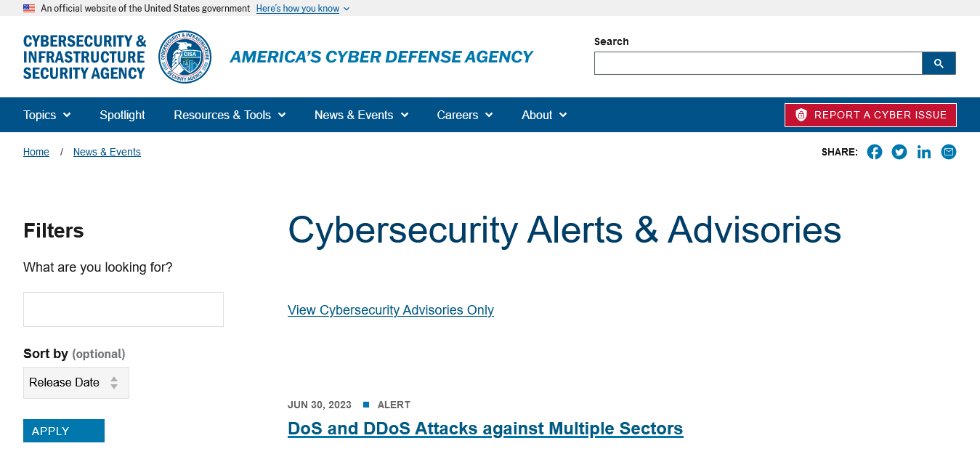
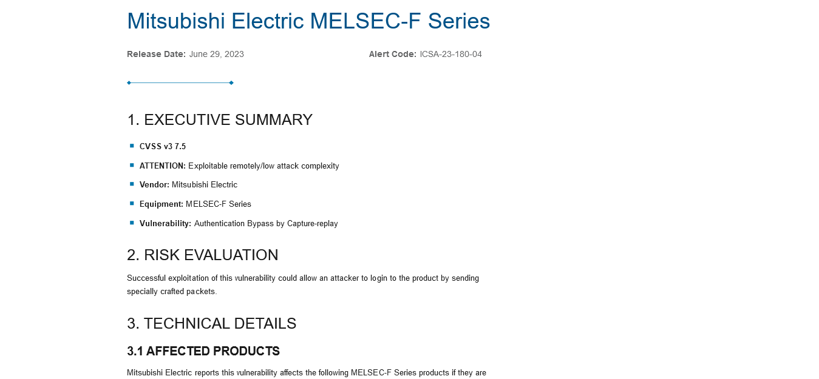
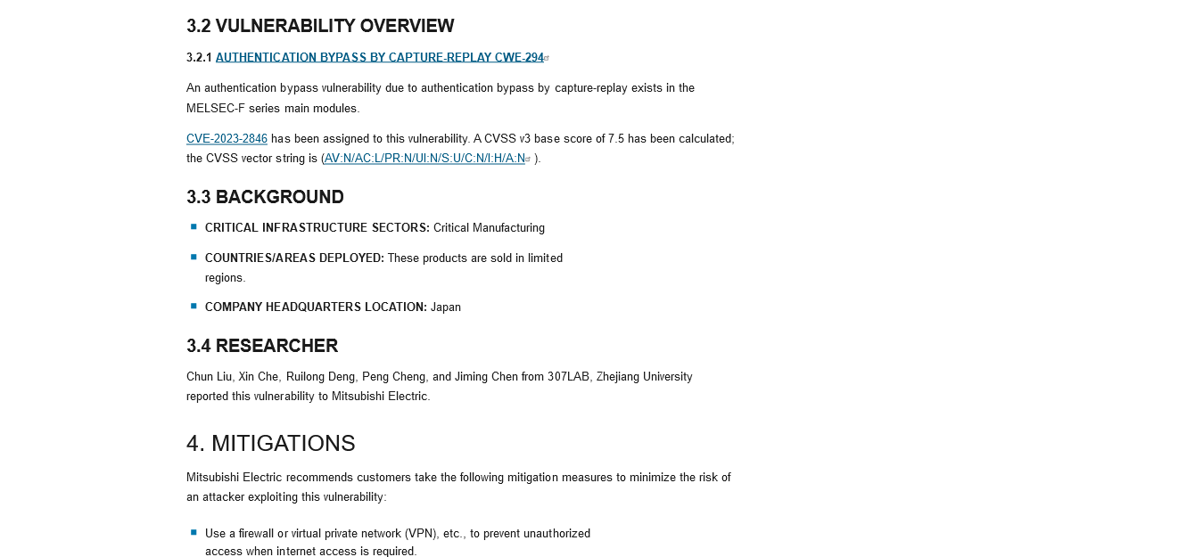
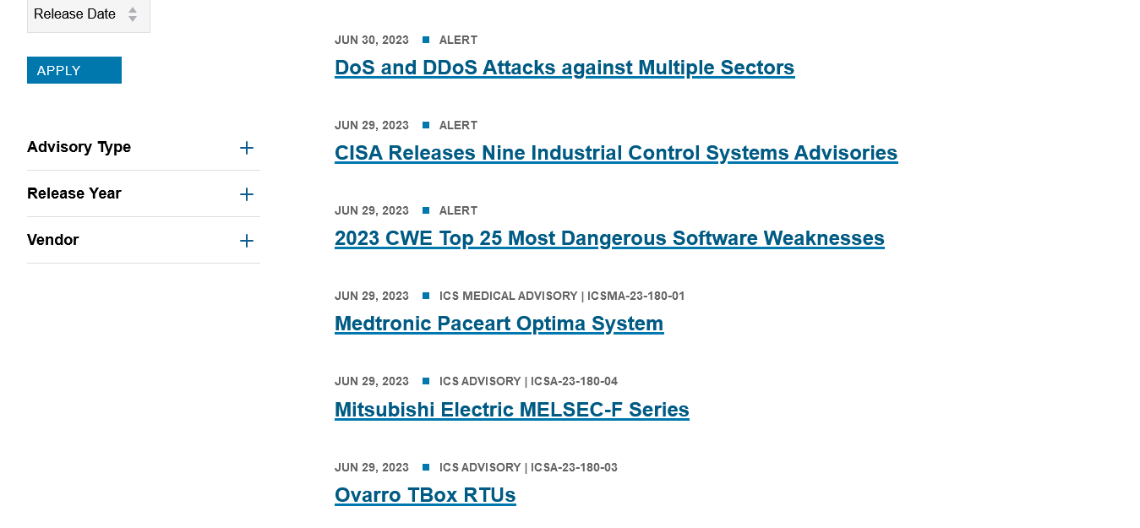
CISA Alerts and Advisories

Slide 12
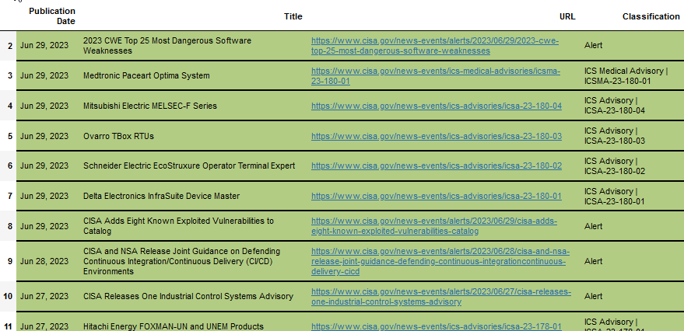



Building a Simple Intel Feed using Text Mining With Python and CISA’s advisories
Sometimes commercial products don’t cover your niche use case.
Custom Built Provides a lot of Flexibility
With some adjustments it can be made into a news aggregator.
libraries: time, pandas, bs4, Ipython.display, and more

